Slide 1

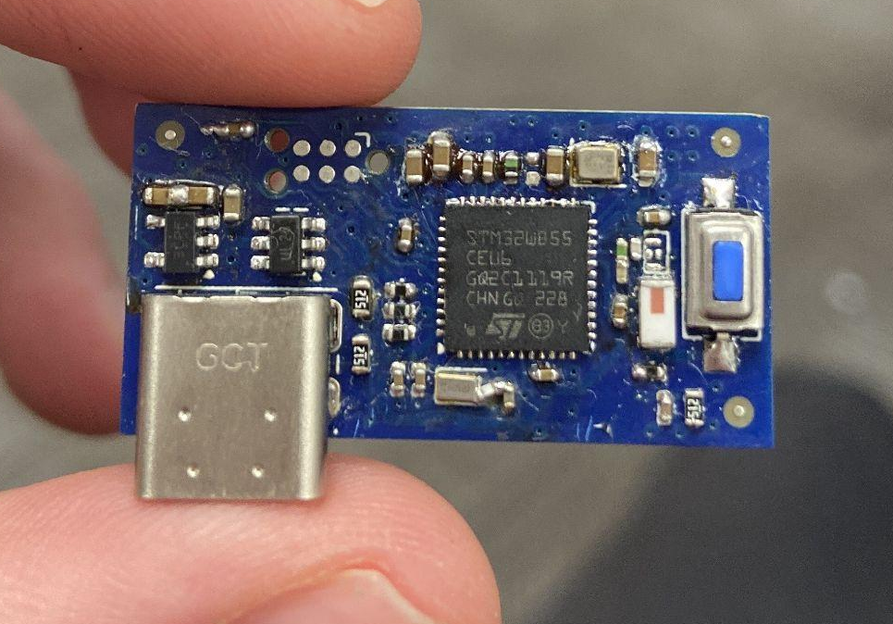
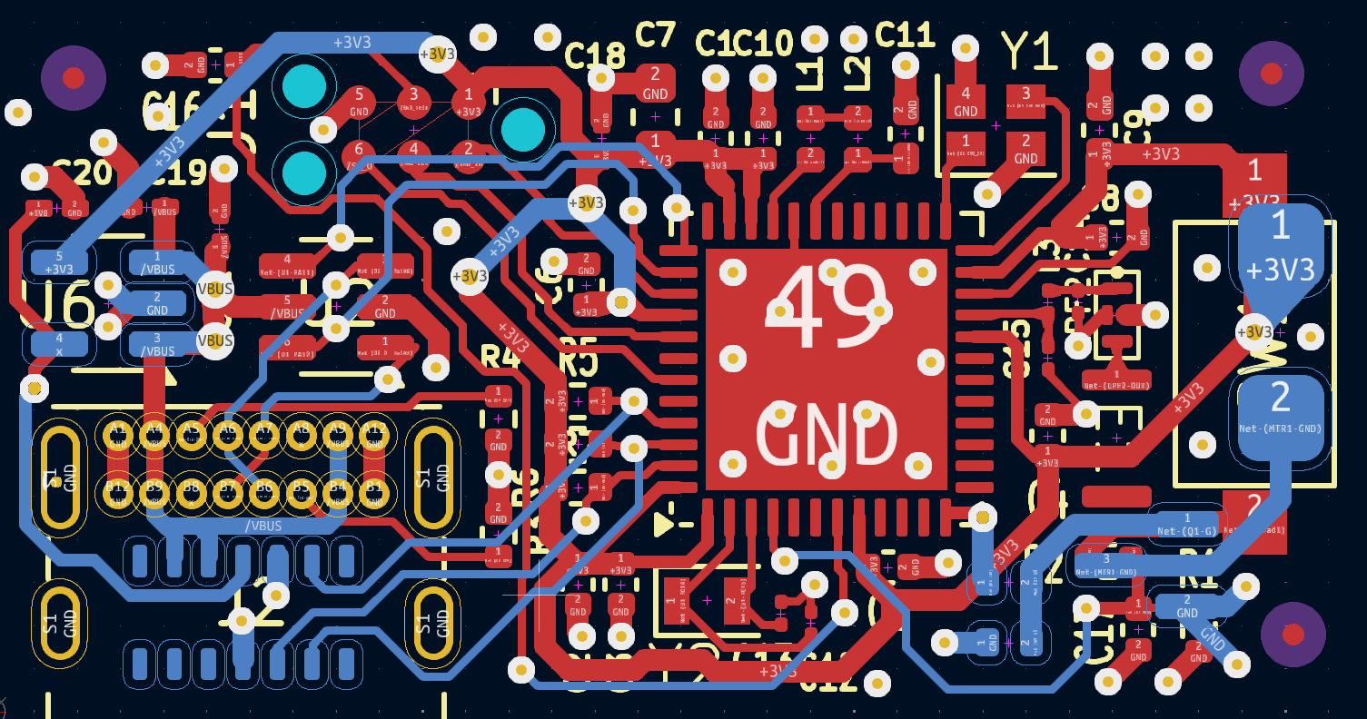
Embedded Heart Monitor Watch:
<N
Stein Witt, Dinali Assylbek, Andy Tran, Hayden Walpole

Slide 2
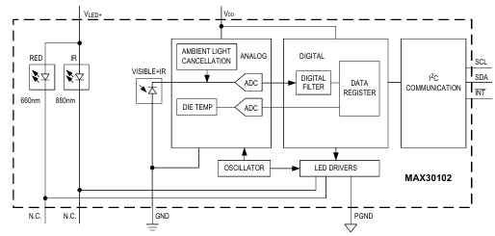
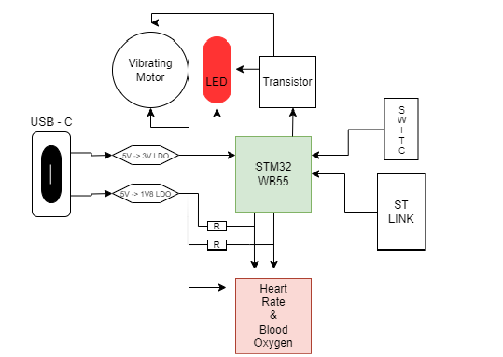
Initial Plan
We aimed to create a Custom PCB with a Sensor capable of measuring Blood Oxygen level and heart rate. A motor or LED would be triggered when either went above a set level.
We used a STM32WB55xx chip to enable Bluetooth connection in the future beyond the scope of this project.
Our device was designed to be powered by USB-C connection in this first prototype stage.
We also purchased a DEV board with this same chip to aid in developing our PCB.

Slide 3
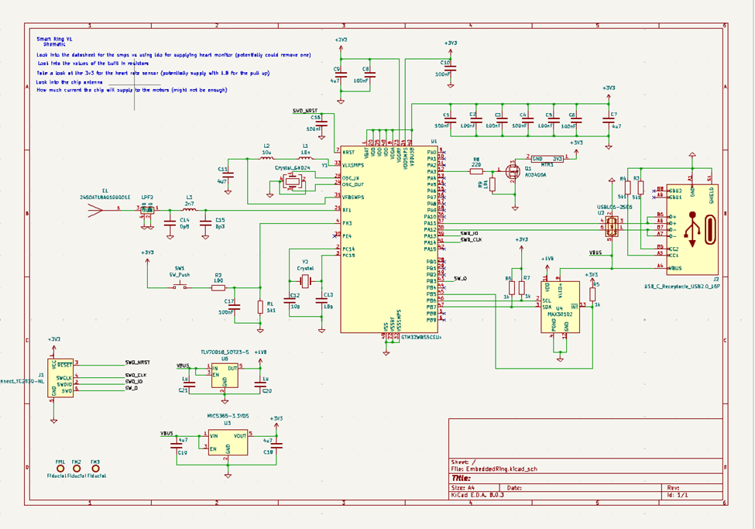
Creating Our PCB: Schematic

Slide 4
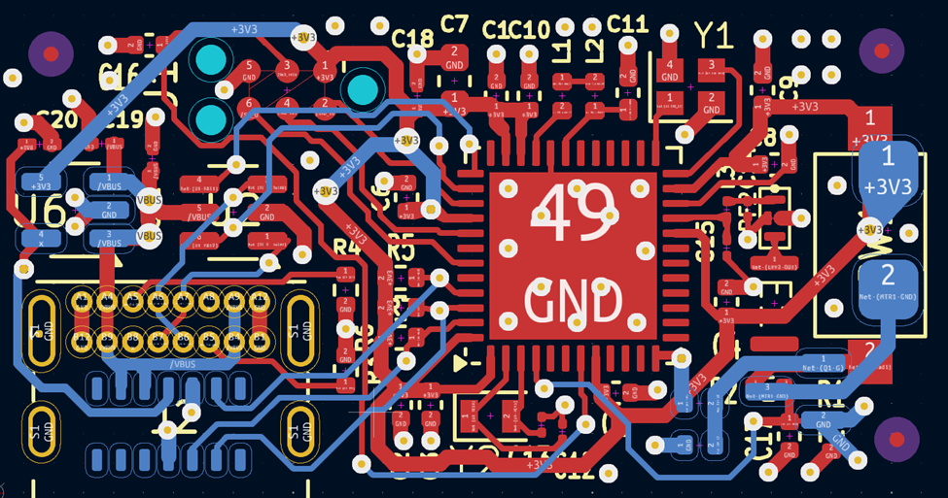
Creating Our PCB: Layout

Slide 5
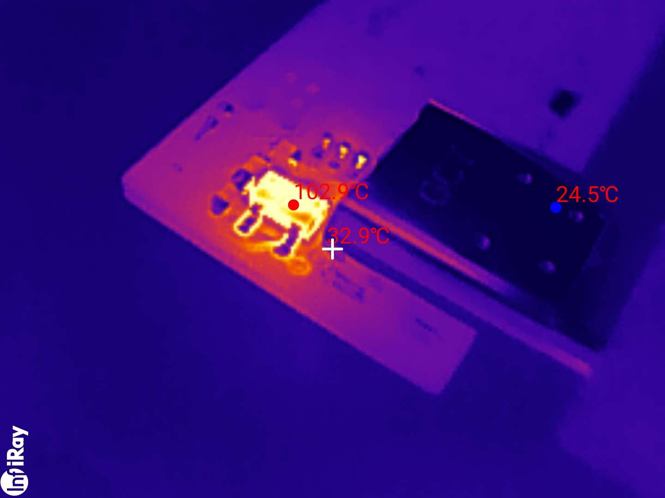
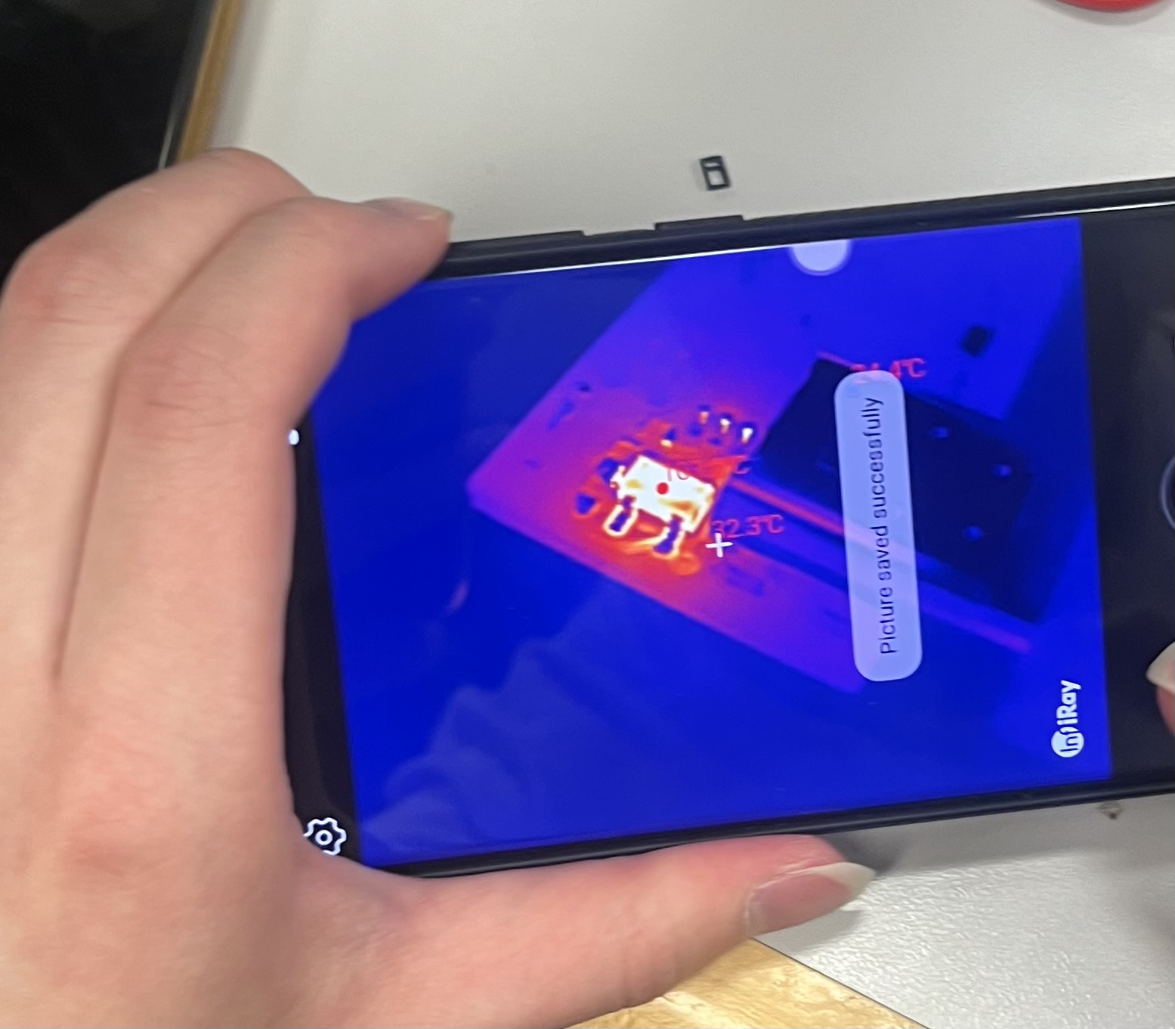
Initial PCB Debugging
Due to the size of our Board we used a reflow oven with help from Ryan in the stock room.
After Plugging into power we discovered a short on our board with a Capciter attached to the LDO being bridged. We were able to resolder and resolve the problem with thermal imaging again.

Slide 6
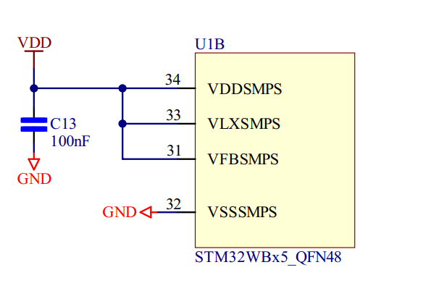
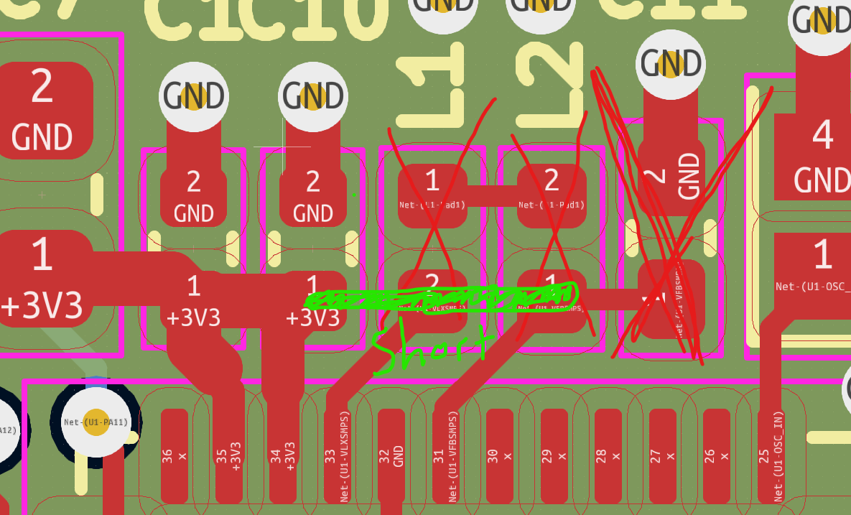
Changing to Low power (LDO) mode
Since an inductor did not ship, we had to improvise and used the LDO configuration to power the core
Recommended solution from STM

Slide 7
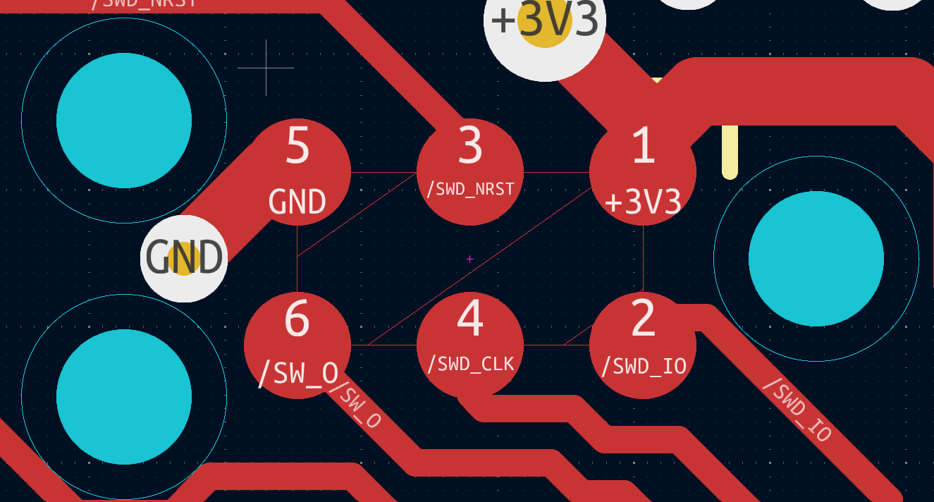
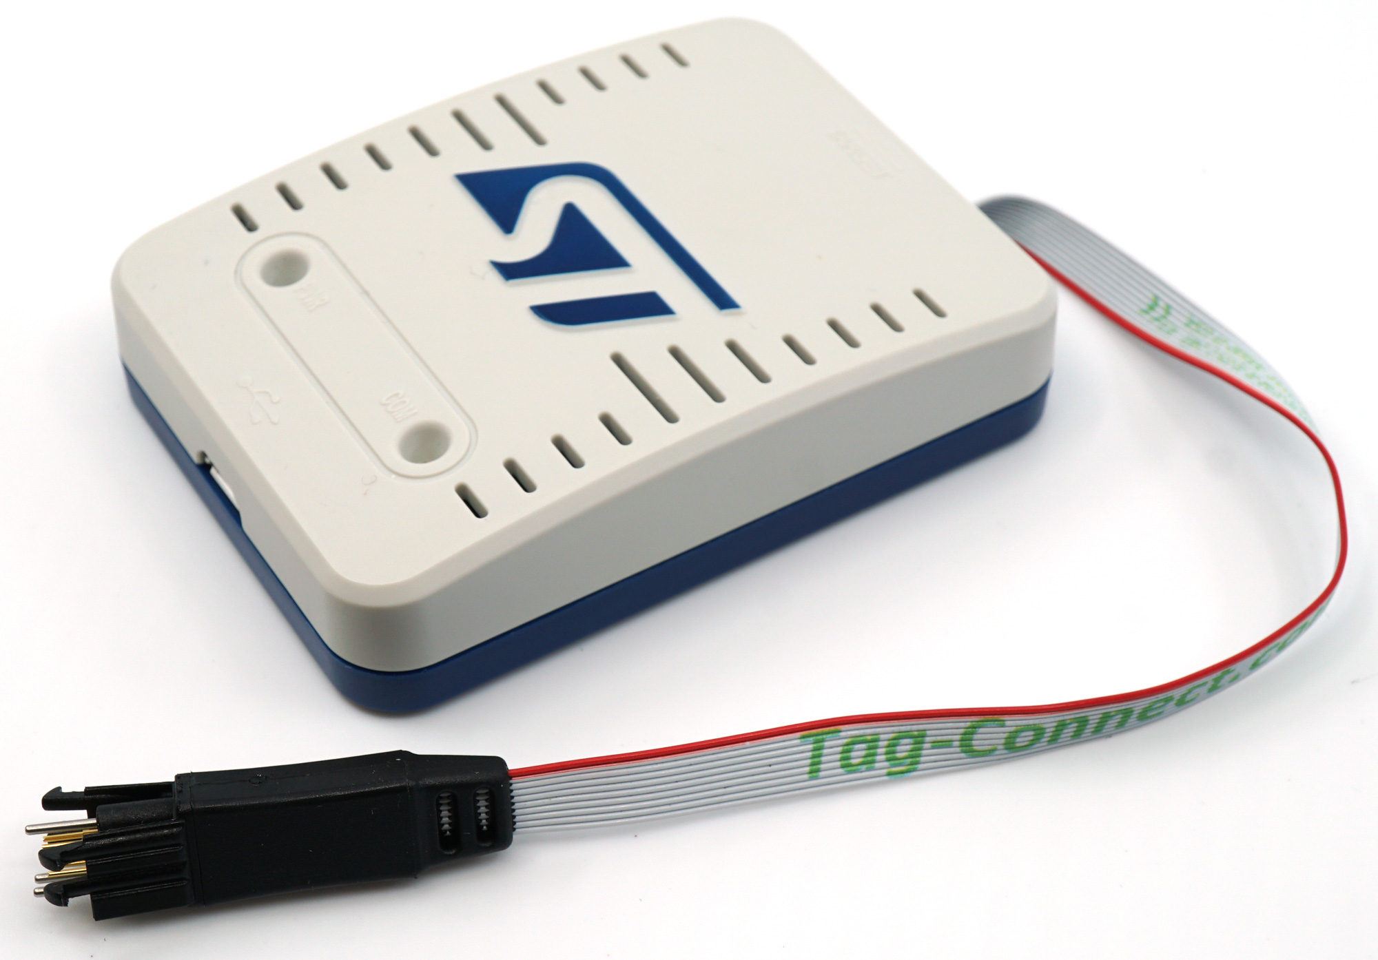
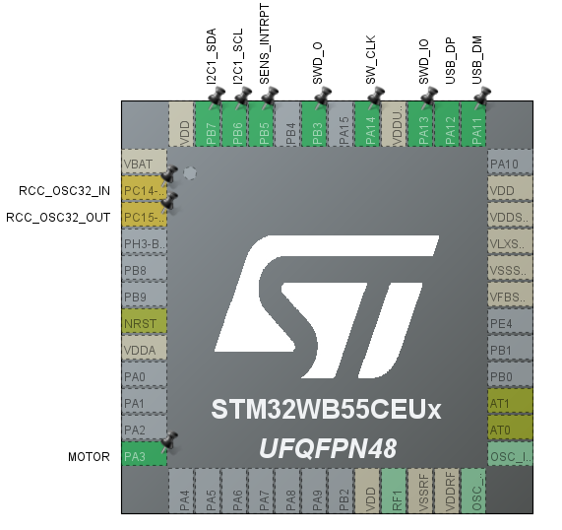
Testing SWD on Dev board
.
Custom SWD Programming Cable using STLink V3
We were able to create test code and run it on the chip on our Dev board to ensure our code would work on the PCB.
The test code was successful on the Dev board.

Slide 8
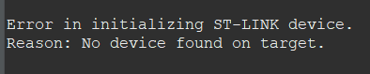
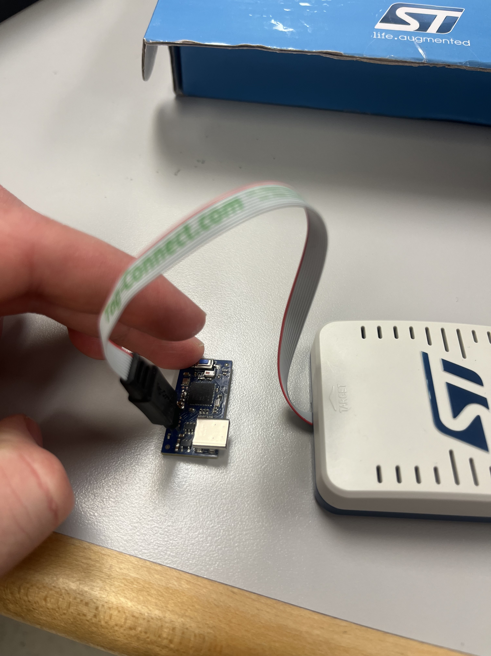
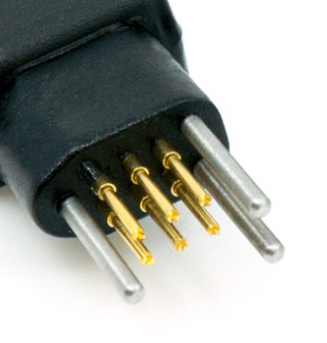
Unable to connect to PCB
With everything hooked up, we were unable to have the chip communicate with our development board using an ST-LINK with a JTAG 6-pin pogo pin connector

Slide 9
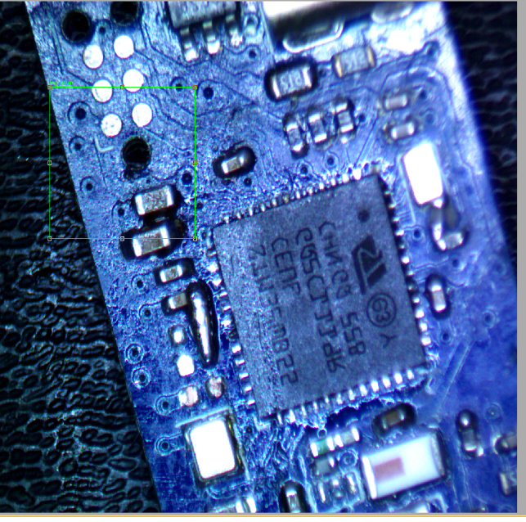
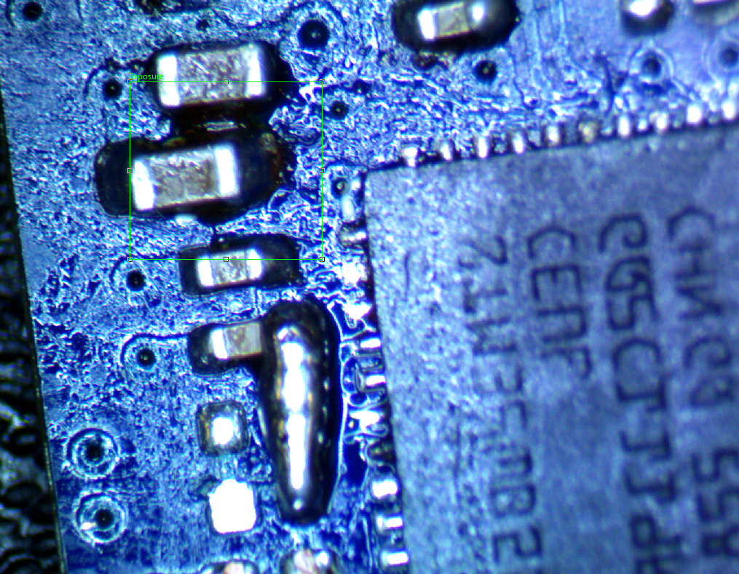
Testing PCB for shorts and difficulties of checking Chip functionality
After Programming our device failed to find the Device over SWD we checked our connections under a Microsoft and probed the lines for shorts and ensured all our power traces were powered. We were unable to find any issues.
Since we were unable to probe the chip we were unable to determine the state of the chip wither it has been heat damaged, Cleared the existing code on the chip, or ruined it when the board was shorted.

Slide 10
Project Key Takeaways
While we did not meet the expectations that we had set for ourselves for this project, we learned some important lessons
Debugging a PCB is difficult, especially when there are many moving parts to factor in.
The smaller the PCB, the harder it is to solder correctly. Connections may be shorted or left hanging. It is very difficult determine these with your naked eye.
Have multiple sets of parts and PCBs ready to go. We lost a lot of time waiting for parts to arrive during development.
We Learned a lot about the Communication used for SWD in flashing commercial chips, And I2C protocols.
Because our Sensor uses I2C it is difficult to communicate with it without a chip.

